Slide 1
CAN (Controller Area Network) protocol presented by P. Pavan Kumar
-------------------------------------------------------------------

Slide 2
CAN (Controller Area Network) protocol
CAN stands for Controller Area Network protocol. It is a protocol that was developed by Robert Bosch in around 1986.
The CAN protocol is a standard designed to allow the microcontroller and other devices to communicate with each other without any host computer.
It is a serial half-duplex and asynchronous type of communication protocol. The CAN is a two-wired communication protocol as the CAN network is connected through the two-wired bus.

Slide 3
Applications of CAN protocol
CAN protocol was designed to target the communication issue that occurs within the vehicles. But later on, due to the features it offers, it is used in various other fields. The following are the applications of CAN protocol:
Automotive (passenger vehicles, trucks, buses)
Electronic equipment for aviation and navigation
Industrial automation and mechanical control
Elevator and escalators
Building automation
Medical instruments and equipment
Marine, medical, industrial, medical

Slide 4
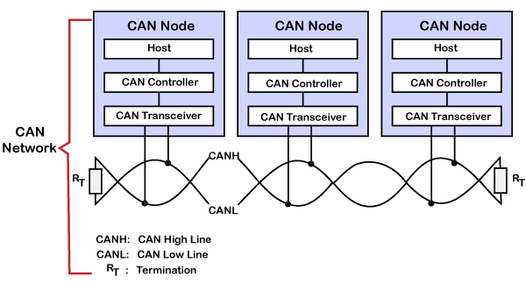
CAN layered architecture
As we know that the OSI model
partitions the communication system into 7 different layers. But the CAN layered architecture consists of two layers, i.e., data-link layer and physical layer.

Slide 5
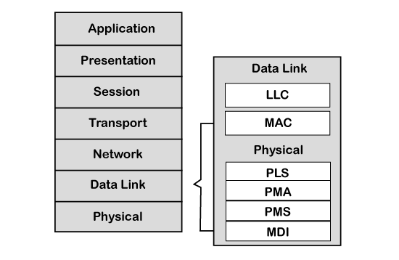
Let's understand both the layers.
L
s.
Data-link layer:
This layer is responsible for node to node data transfer. It allows you to establish and terminate the connection.
It is also responsible for detecting and correcting the errors that may occur at the physical layer. Data-link layer is subdivided into two sub-layers:

Slide 6
-----------------------------------------------------
MAC: MAC stands for Media Access Control. It defines how devices in a network gain access to the medium. It provides Encapsulation and Decapsulation of data, Error detection, and signaling.
LLC: LLC stands for Logical link control. It is responsible for frame acceptance filtering, overload notification, and recovery management.
Physical layer: The physical layer is responsible for the transmission of raw data. It defines the specifications for the parameters such as voltage level, timing, data rates, and connector.

Slide 7
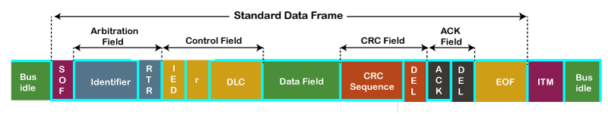
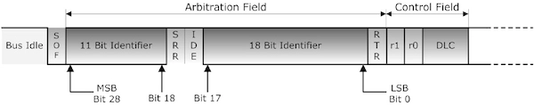
Let's understand the structure of the CAN frame.

Slide 8
Frame Types:
Based on purpose of frame: - Data frame: a frame containing node data for transmission
Remote frame: a frame requesting the transmission of a specific identifier
Error frame: a frame transmitted by any node detecting an error –
Overload frame: a frame to inject a delay between data or remote frame
Based on Arbitration field :
Standard or Extended
Standard - Extended

Slide 9
CAN Protocol: DATA Frame
The data frame is the only frame for actual data transmission. There are two message formats:
Standard frame format: with 11 identifier bits
Extended frame format: with 29 identifier bits
The CAN standard requires that the implementation must accept the base frame format and may accept the extended frame format, but must tolerate the extended frame format.

Slide 10
-----------------------------------------------------
SOF: SOF stands for the start of frame, which indicates that the new frame is entered in a network. It is of 1 bit.
Identifier: A standard data format defined under the CAN 2.0 A specification uses an 11-bit message identifier for arbitration. Basically, this message identifier sets the priority of the data frame.
RTR: RTR stands for Remote Transmission Request, which defines the frame type, whether it is a data frame or a remote frame. It is of 1-bit.
Control field: It has user-defined functions.
IDE: An IDE bit in a control field stands for identifier extension. A dominant IDE bit defines the 11-bit standard identifier, whereas recessive IDE bit defines the 29-bit extended identifier.
DLC: DLC stands for Data Length Code, which defines the data length in a data field. It is of 4 bits.
Data field: The data field can contain upto 8 bytes.

Slide 11
-----------------------------------------------------
CRC field: The data frame also contains a cyclic redundancy check field of 15 bit, which is used to detect the corruption if it occurs during the transmission time. The sender will compute the CRC before sending the data frame, and the receiver also computes the CRC and then compares the computed CRC with the CRC received from the sender. If the CRC does not match, then the receiver will generate the error.
ACK field: This is the receiver's acknowledgment. In other protocols, a separate packet for an acknowledgment is sent after receiving all the packets, but in case of CAN protocol, no separate packet is sent for an acknowledgment.
EOF: EOF stands for end of frame. It contains 7 consecutive recessive bits known End of frame.

Slide 12
CAN Extended Frame Format:
SRR:
It stands for Substitute Remote Request. This bit replaces RTR bit of standard CAN message location as placeholder in this extended CAN format.
IDE:
It functions as recessive bit in identifier extension. It indicates that more identifier bits are followed. 18 bit extension follows IDE.
R1: It is additional reserved bit for future use.

Slide 13
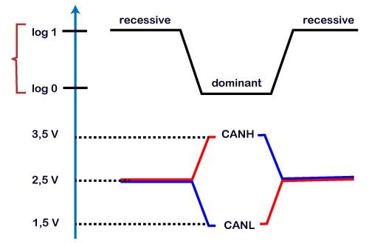
CAN Characteristics

Slide 14
Key points learnt from the CAN characteristics
Logic 1 is a recessive state. To transmit 1 on CAN bus, both CAN high and CAN low should be applied with 2.5V.
Logic 0 is a dominant state. To transmit 0 on CAN bus, CAN high should be applied at 3.5V and CAN low should be applied at 1.5V.
The ideal state of the bus is recessive.
If the node reaches the dominant state, it cannot move back to the recessive state by any other node.

Slide 15
Advantages and disadvantages of CAN protocol
Advantages:
1.Multimaster and multi slave
2.Error detection and correction
3.Low cost [Two-wire]
4.Data wire
5.Acknowledgement Facility
Disadvantages:
1.It supports up to 64 nodes at a maximum distance of 400 meters.
2.It is half-duplex communication protocol.

Slide 16
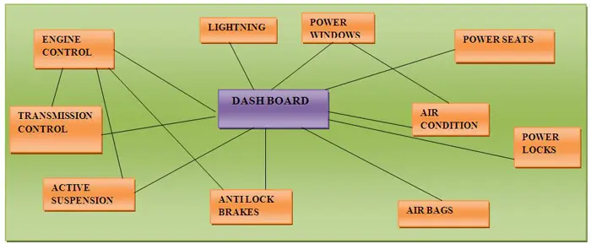
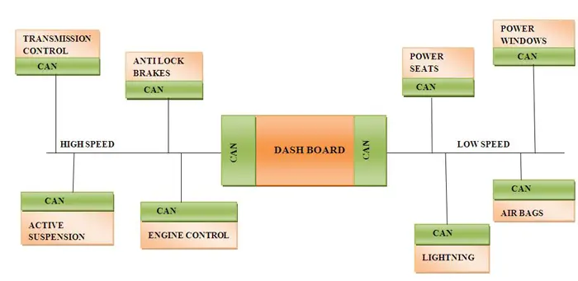

Slide 17
The Tesla Model 3 uses the ISO 15765-4 CAN bus protocol. Additionally, it uses an 11-bit header and communicates over a 500000 baud rate.

